Slide 1
Depth Optimized Quantum Circuits
for HIGHT and LEA
Kyungbae Jang, Yujin Oh, Minwoo Lee, Dukyoung Kim, Hwajeong Seo
https://youtu.be/jjuplL3kvVY

Slide 2
Contents
Our Contribution
Preliminaries
Proposed Quantum Circuits for HIGHT and LEA
Evaluation
Conclusion

Slide 3
Contributions
Depth-optimized quantum circuits for LEA and HIGHT
We achieve depth reductions of 48% and 74% for HIGHT and LEA, respectively.
Multiple methods for effectively reducing circuit depth are gathered in this work.
The implementation methods can be adopted for generic quantum circuit
implementations.
The required quantum complexities for HIGHT and LEA are redefined in this work.
Post-quantum security level for HIGHT and LEA are re-evaluated.

Slide 4
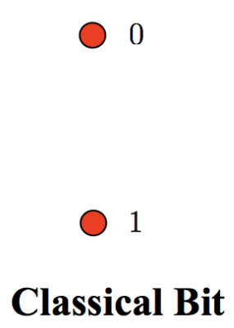
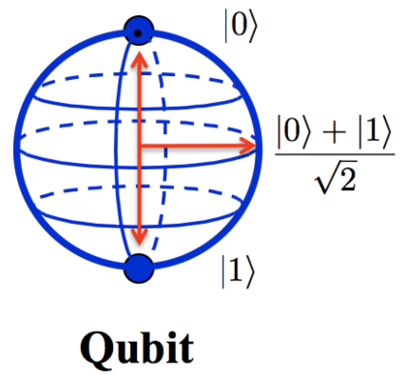
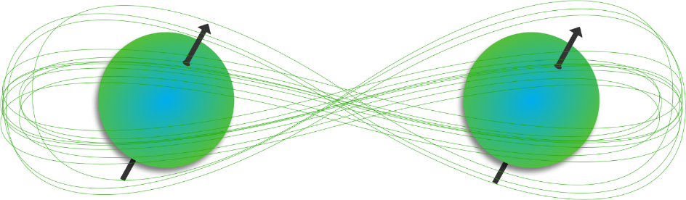

Quantum Computing
Qubit (Quantum bit)
Superposition
Entanglement

Slide 5
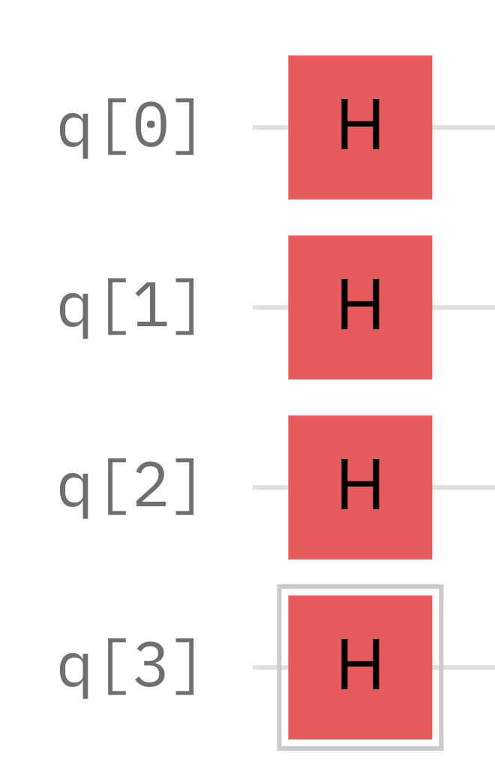
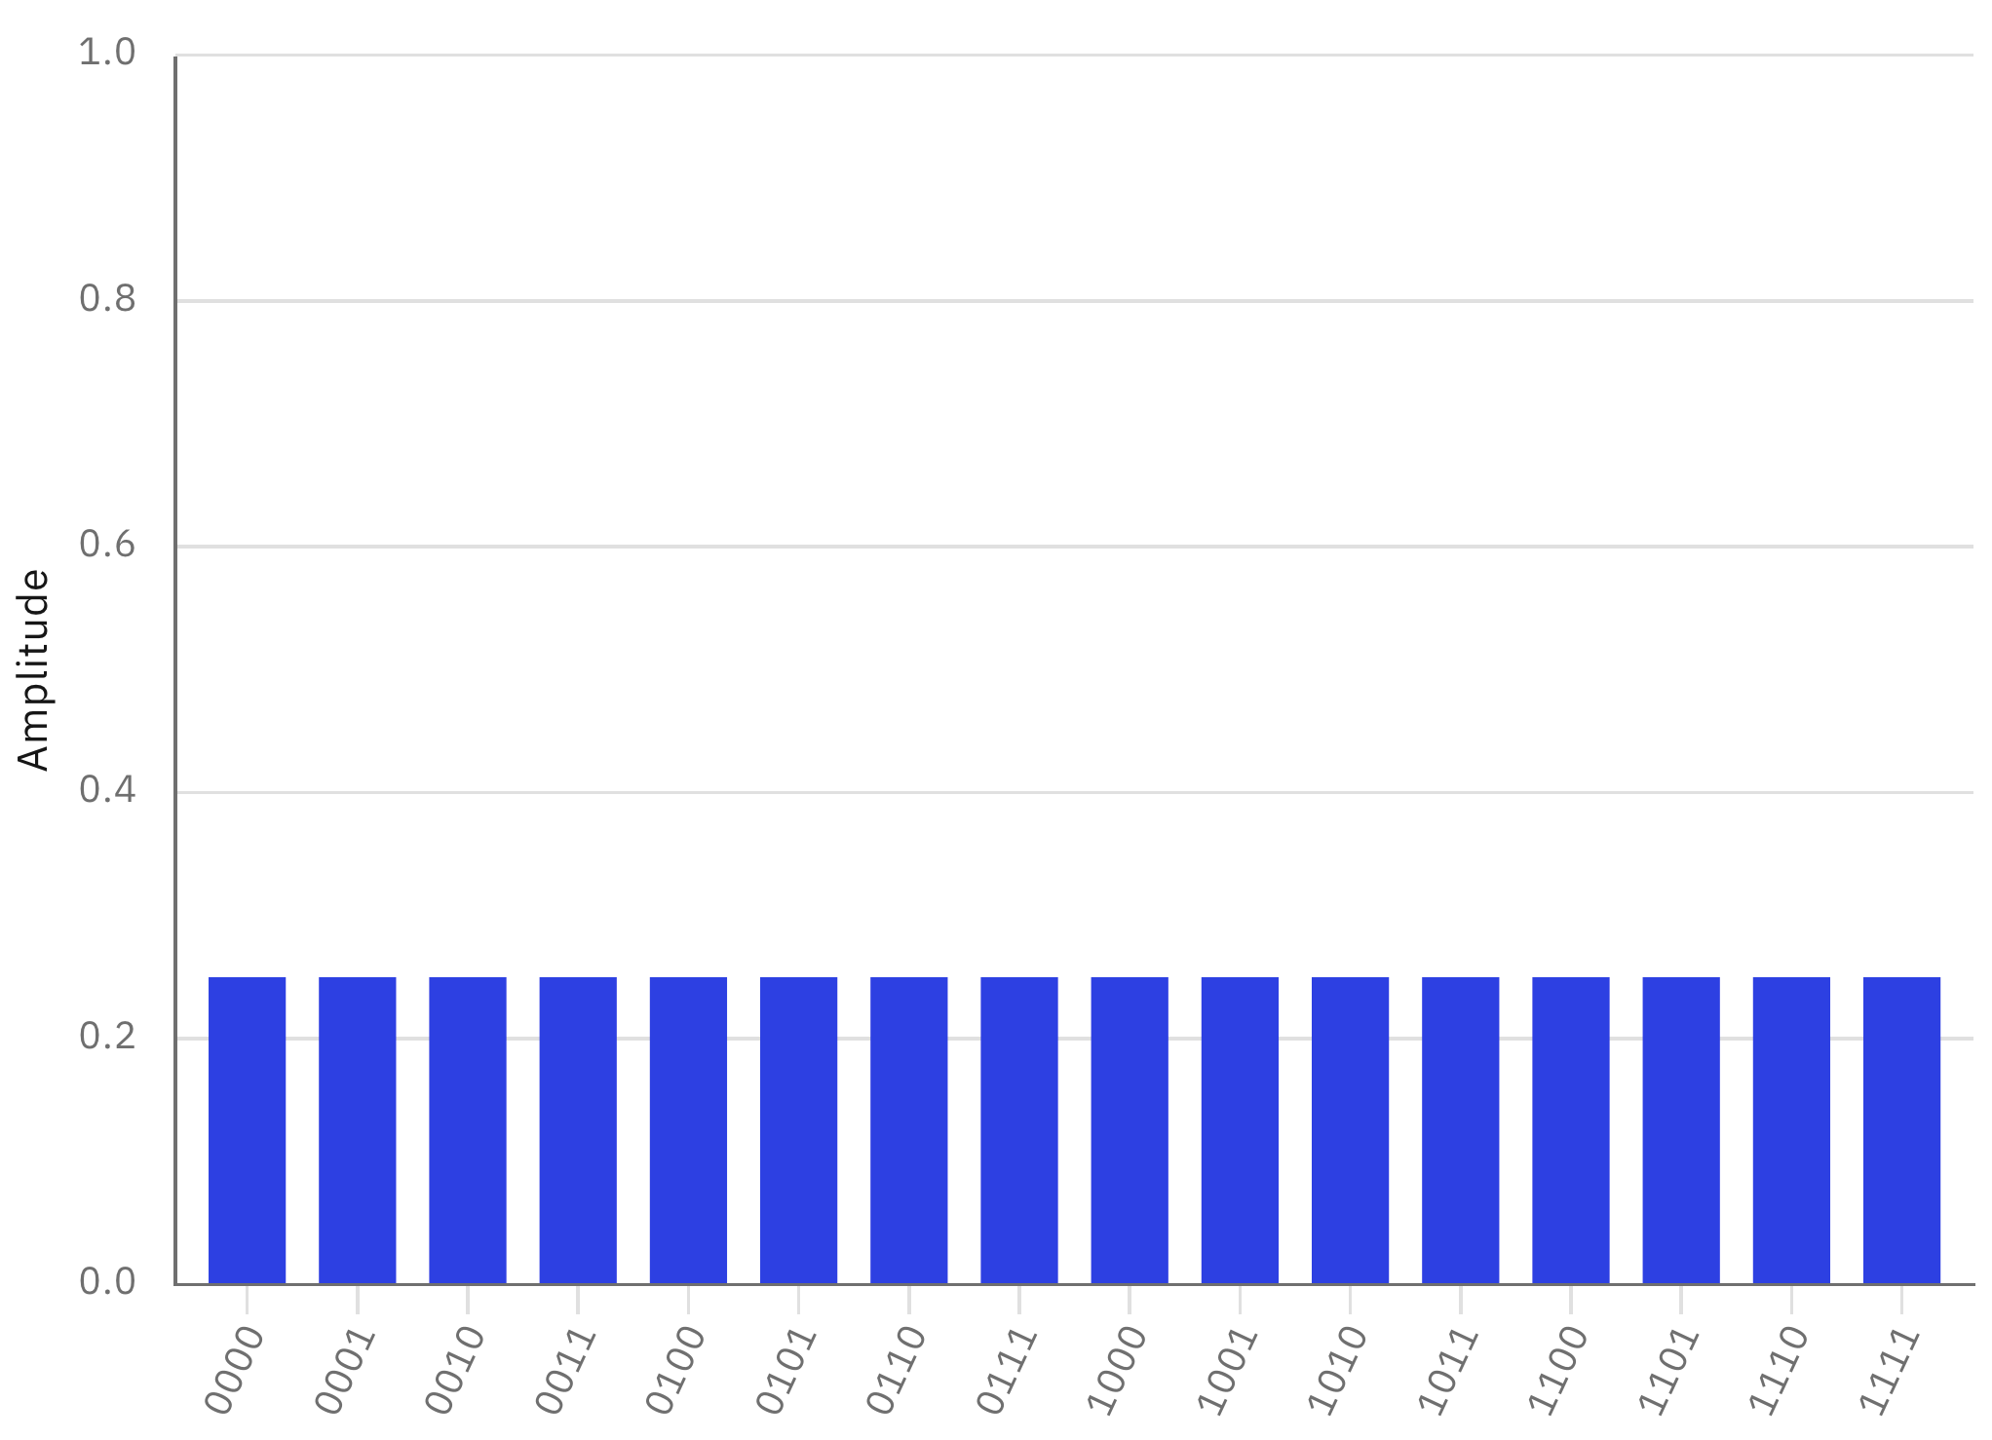
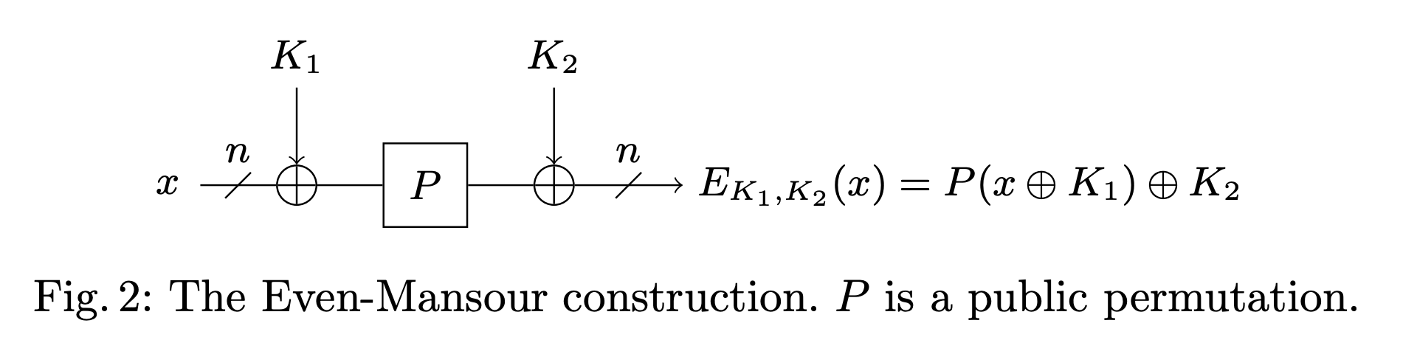
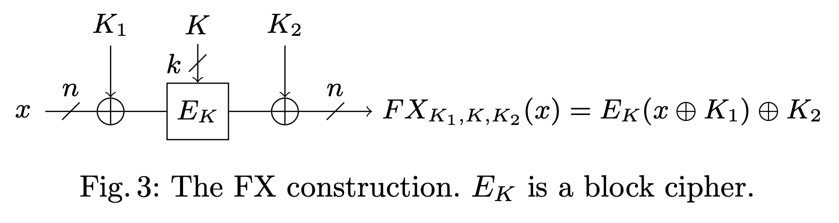
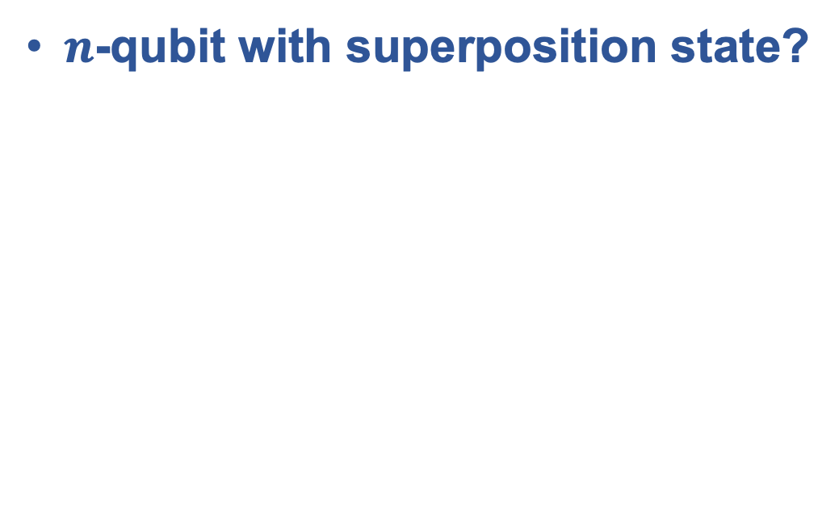
Quantum Computing
$n$-qubit with superposition state?
We can prepare $2^{n}$ states (as probability) at once!
With proper quantum algorithm? (Shor, Grover, Simon etc…)
→ Meaningful result can be achieved

Slide 6
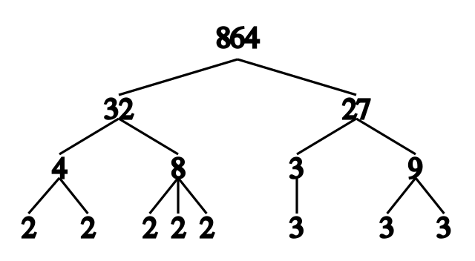
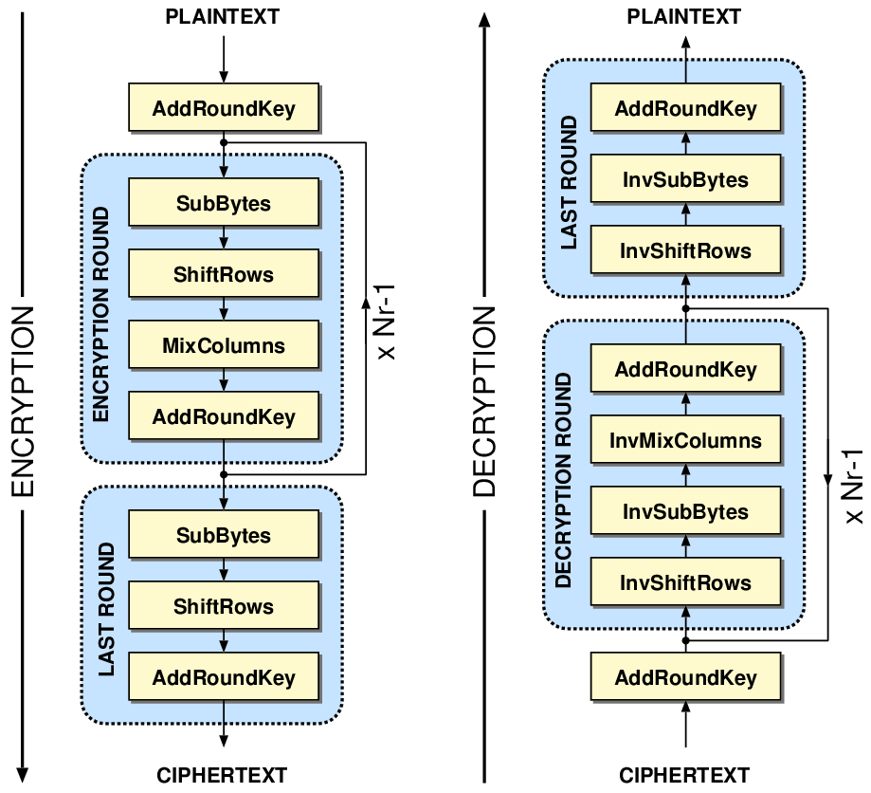

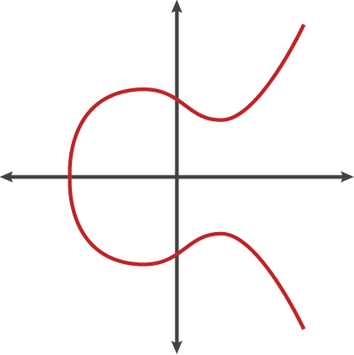
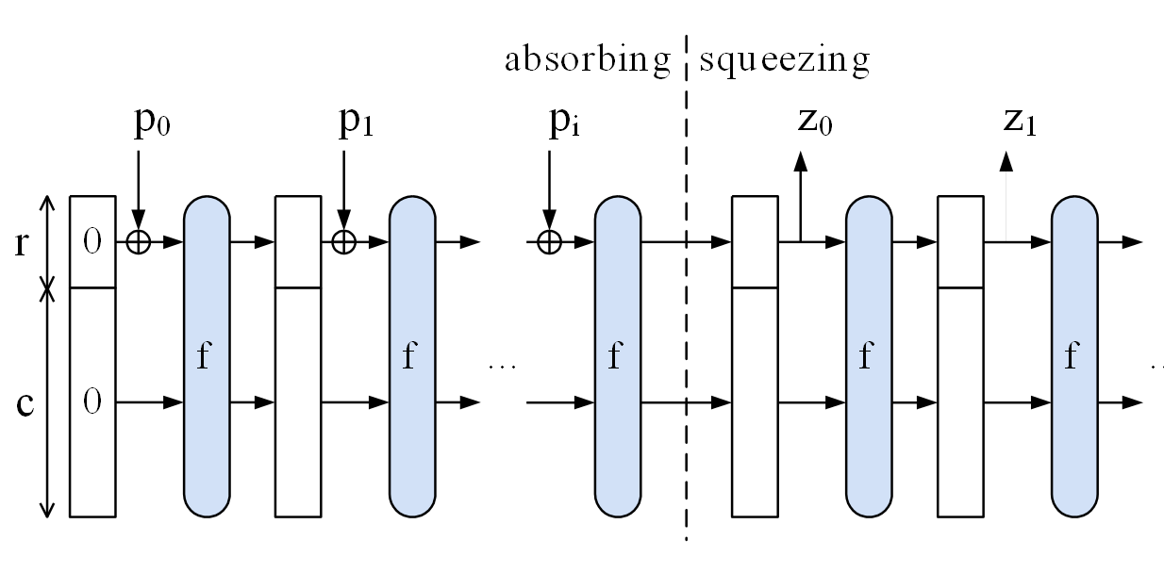
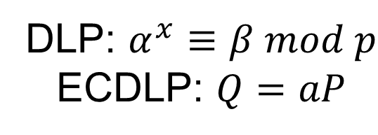
Cryptosystems in Quantum World
Shor’s Algorithm
Grover’s Algorithm
DLP: $α^{x}≡β mod p$
ECDLP: $Q=aP$

Slide 7
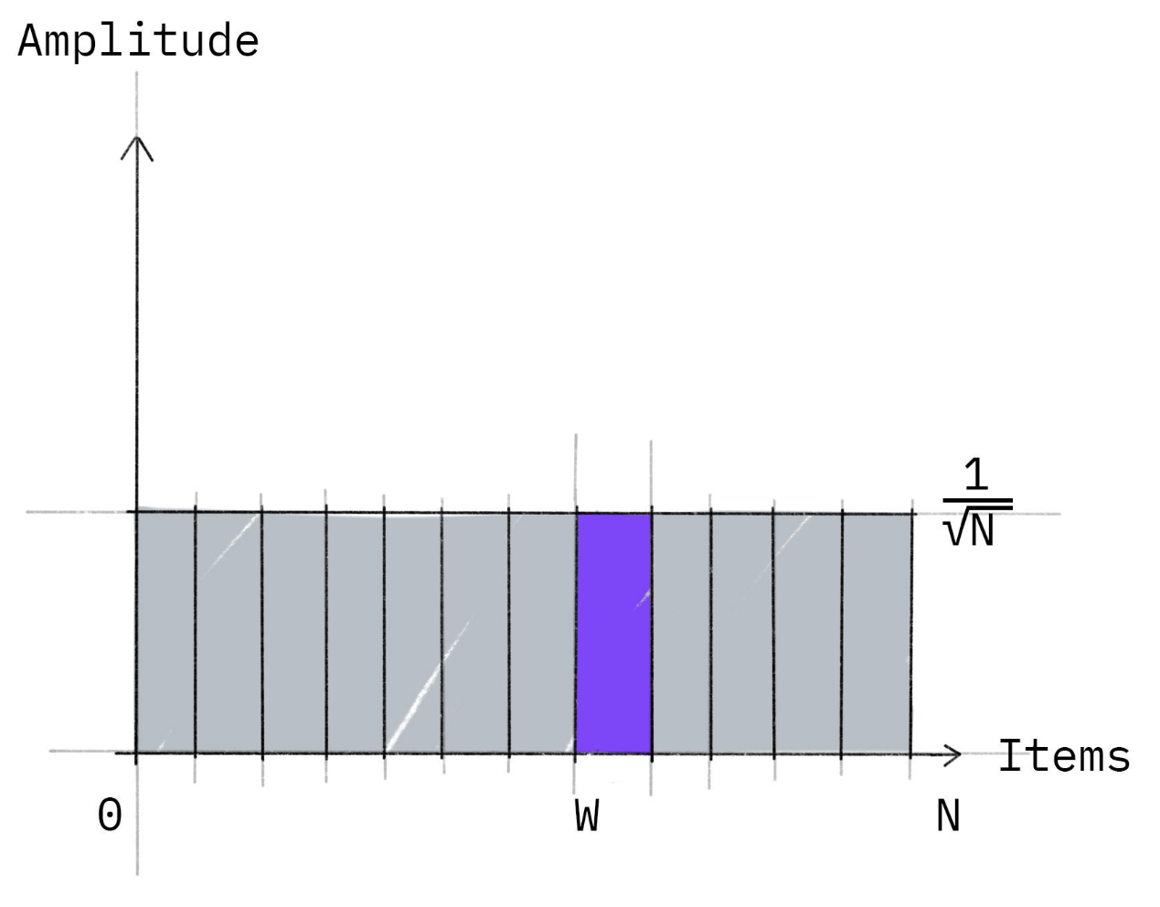
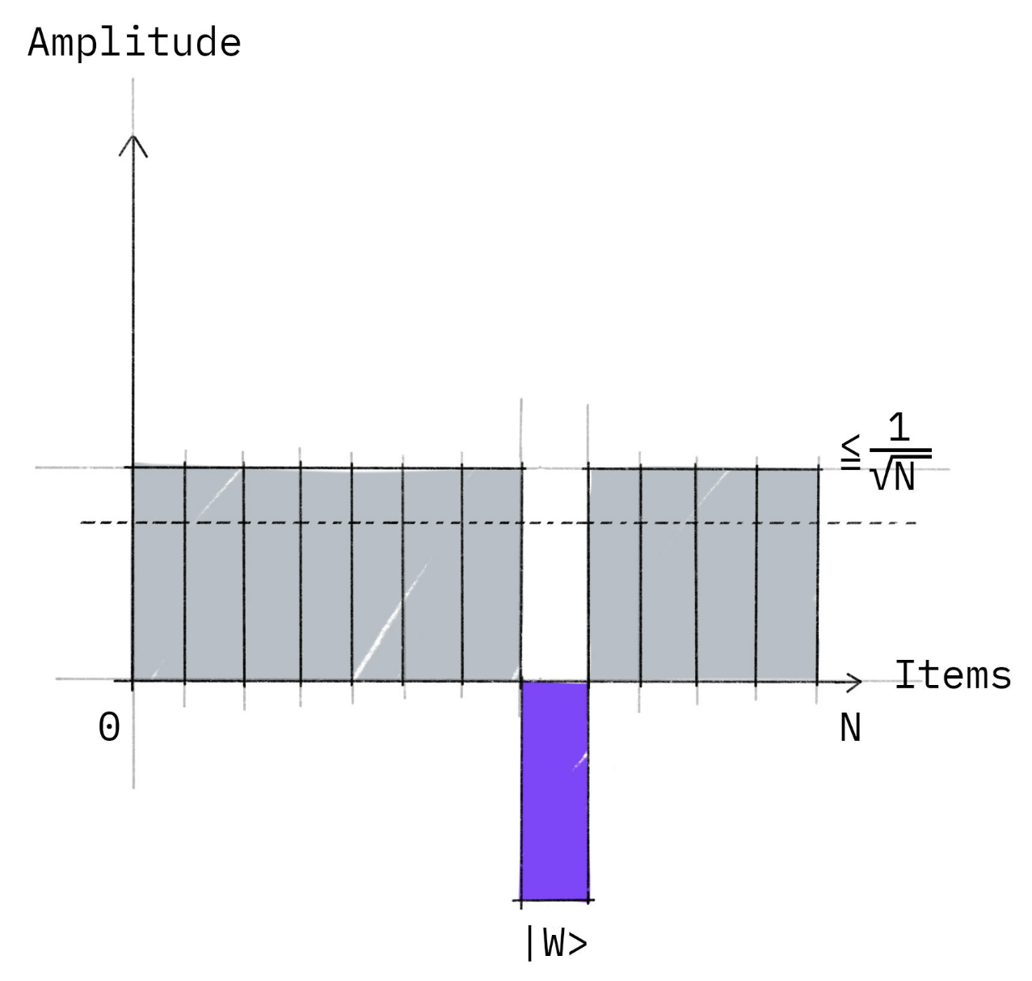
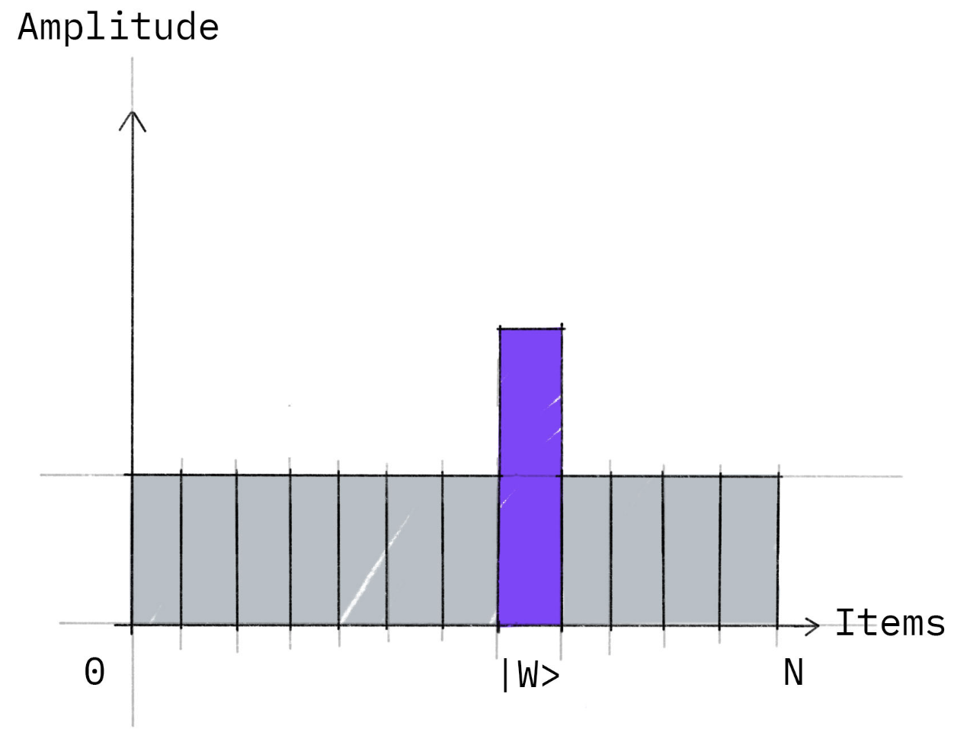
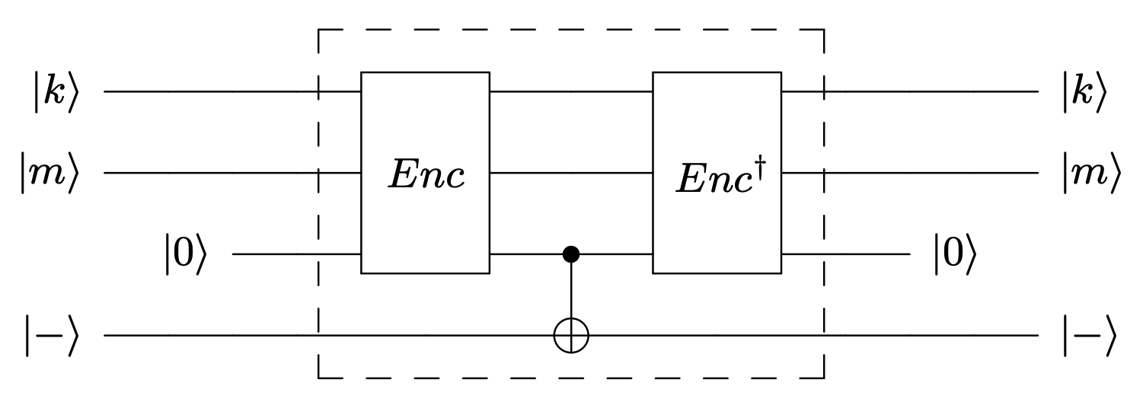
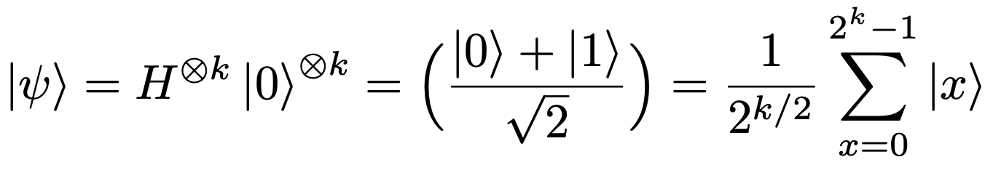
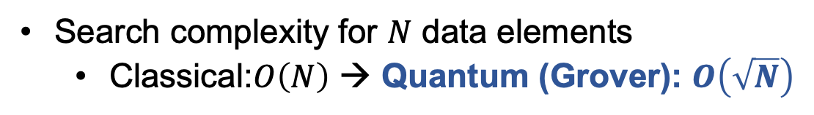
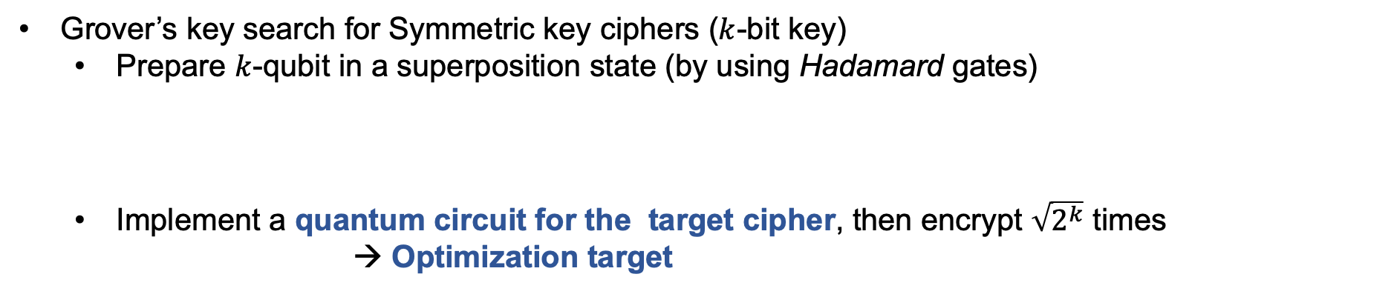
Grover’s Algorithm
Search complexity for $N$ data elements
Classical:$O\left(N\right)$ → Quantum (Grover): $O\left(\sqrt{N}\right)$
Superposition state
Oracle
Diffusion operator
Grover’s key search for Symmetric key ciphers ($k$-bit key)
Prepare $k$-qubit in a superposition state (by using Hadamard gates)
Implement a quantum circuit for the target cipher, then encrypt $\sqrt{2^{k}}$ times
→ Optimization target
Oracle

Slide 8
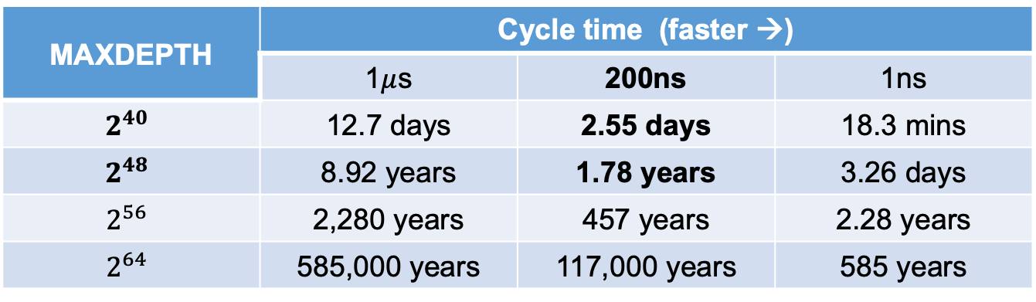
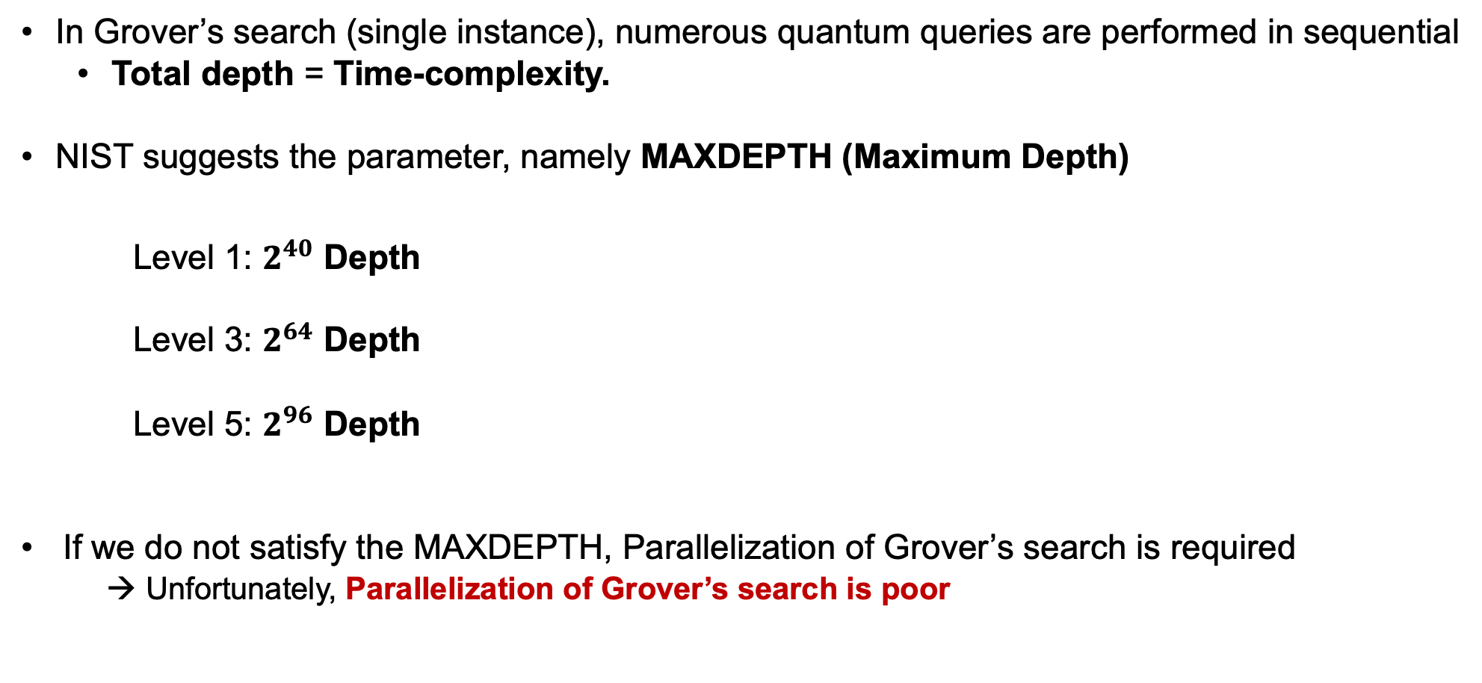
Maximum Depth (MAXDEPTH)
In Grover’s search (single instance), numerous quantum queries are performed in sequential
Total depth = Time-complexity.
NIST suggests the parameter, namely MAXDEPTH (Maximum Depth)
Level 1: $2^{40}$ Depth
Level 3: $2^{64}$ Depth
Level 5: $2^{96}$ Depth
If we do not satisfy the MAXDEPTH, Parallelization of Grover’s search is required
→ Unfortunately, Parallelization of Grover’s search is poor
MAXDEPTH | Cycle time (faster →)
 | 1$μ$s | 200ns | 1ns
$$2^{40}$$ | 12.7 days | 2.55 days | 18.3 mins
$$2^{48}$$ | 8.92 years | 1.78 years | 3.26 days
$$2^{56}$$ | 2,280 years | 457 years | 2.28 years
$$2^{64}$$ | 585,000 years | 117,000 years | 585 years
: near-term and plausible

Slide 9
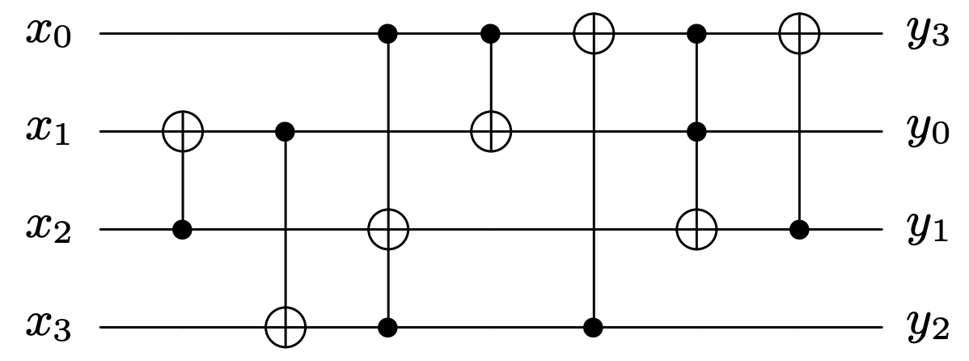
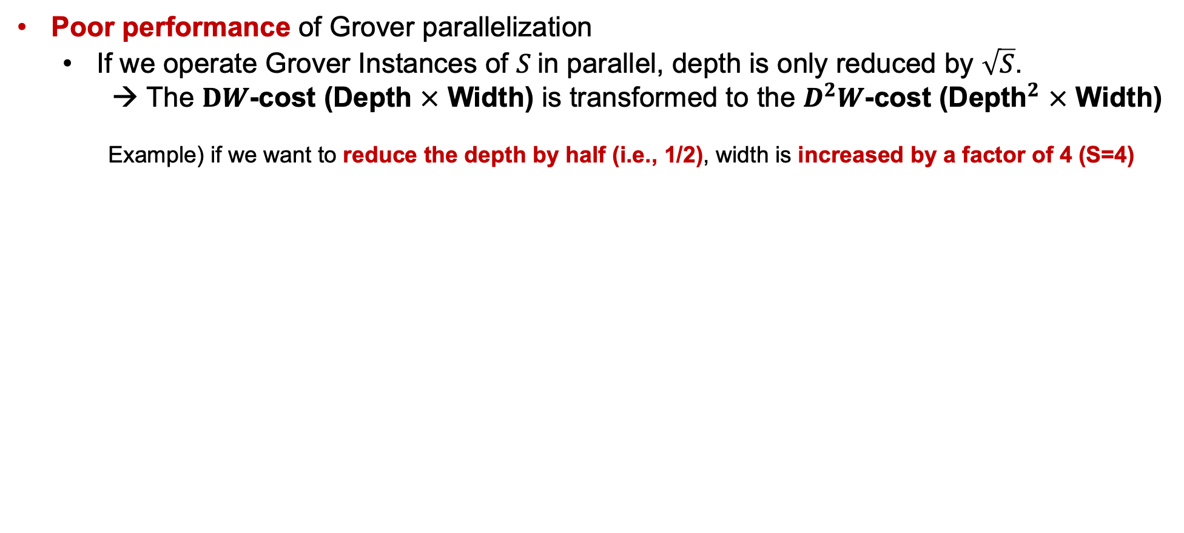
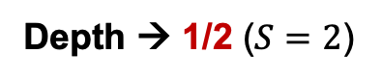
Grover parallelization
Poor performance of Grover parallelization
If we operate Grover Instances of $S$in parallel, depth is only reduced by $\sqrt{S}$.
→ The $DW$-cost (Depth $×$ Width) is transformed to the $D^{2}W$-cost (${\text{Depth}}^{2}$ $×$ Width)
Example) if we want to reduce the depth by half (i.e., 1/2), width is increased by a factor of 4 (S=4)
Full
Depth → 1/2 ($S=2$)
Width → X 4
(Qubits)
This is why we should optimize the depth for Grover’s key search !!

Slide 10
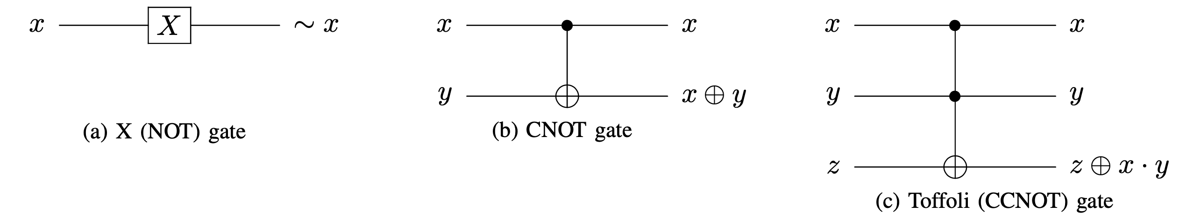
Basic Quantum Gates
The NOT (X) gate replaces classical NOT operation
The CNOT gate replaces classical XOR operation
The Toffoli gate replaces classical AND operation

Slide 11
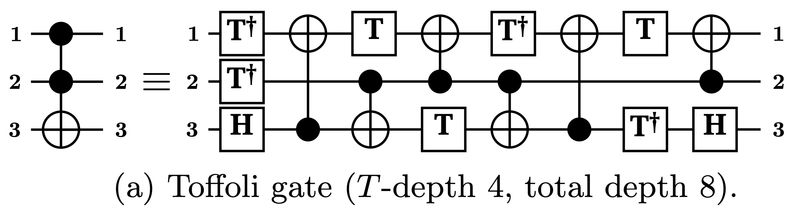
Toffoli gate
Actually, the Toffoli gates are more complex than other quantum gates
*
*
M. Amy, D. Maslov, M. Mosca, M. Roetteler, and M. Roetteler, “A meet- in-the-middle algorithm for fast synthesis of depth-optimal quantum circuits,”

Slide 12
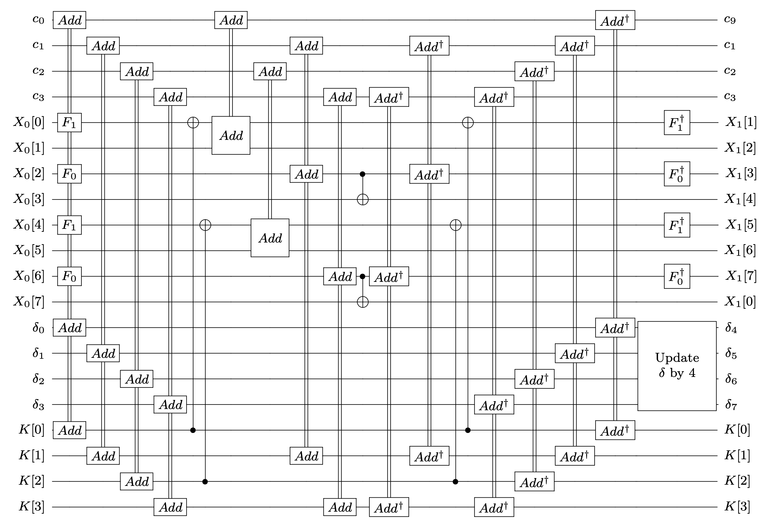
HIGHT quantum circuit
We present a Shallow architecture for HIGHT
In the previous implementation (QIP’22), there is an overhead for the reverse operation
In quantum implementations, the
reverse operation is often utilized to
initialize ancilla qubits and reuse them.
In our Shallow architecture, there is
no depth overhead for the reverse
operation.
*
Jang et al “Parallel Quantum Addition for Korean Block Ciphers”, Quantum Information Processing, 2022.

Slide 13
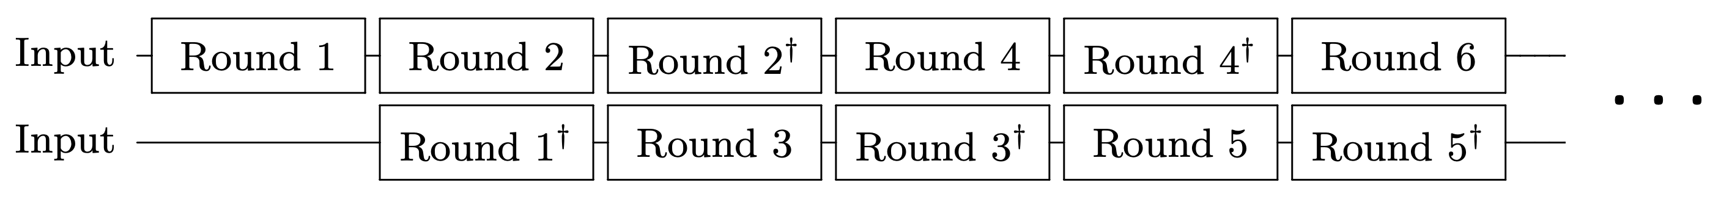
HIGHT quantum circuit
In the previous work, the subsequent round function is delayed until the completion of the
reverse operation of the current round function.
→ Since the current and subsequent round functions share the ancilla qubits each other.
In the shallow architecture, the reverse operation of the current round function is performed
simultaneously with the subsequent round function (i.e., in parallel).
→ we run two sets of ancilla qubits by allocating additional ancilla qubits for the subsequent
round function.

Slide 14
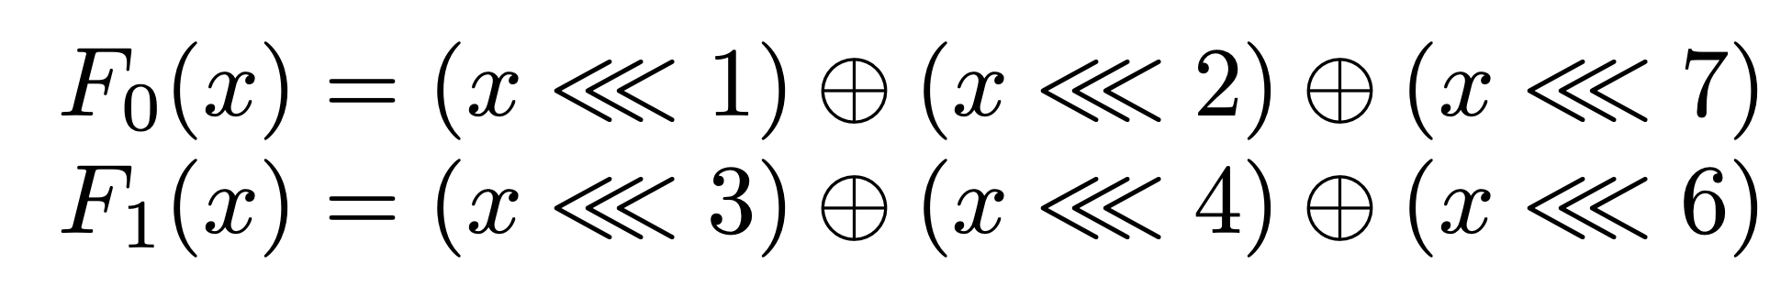
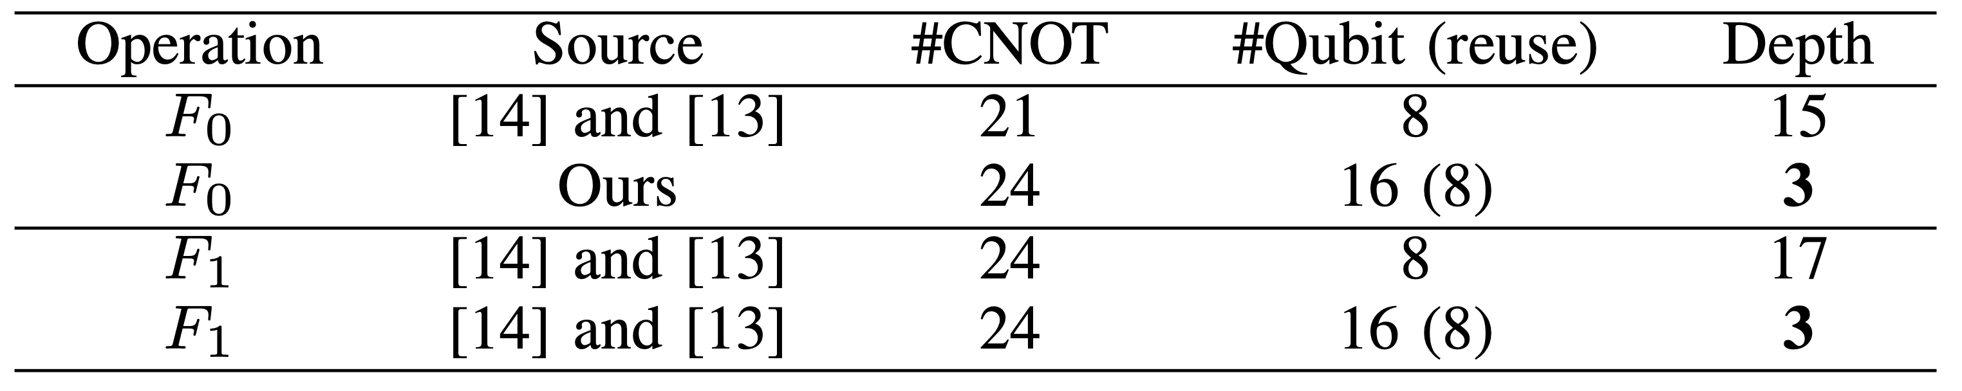
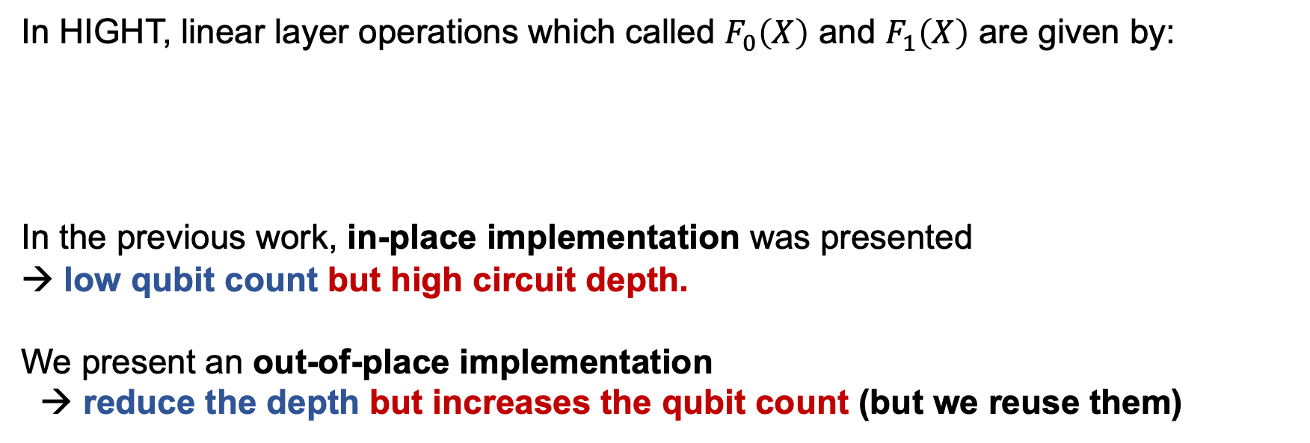
HIGHT quantum circuit
In HIGHT, linear layer operations which called $F_{0}\left(X\right)$ and $F_{1}\left(X\right)$ are given by:
In the previous work, in-place implementation was presented
→ low qubit count but high circuit depth.
We present an out-of-place implementation
→ reduce the depth but increases the qubit count (but we reuse them)

Slide 15
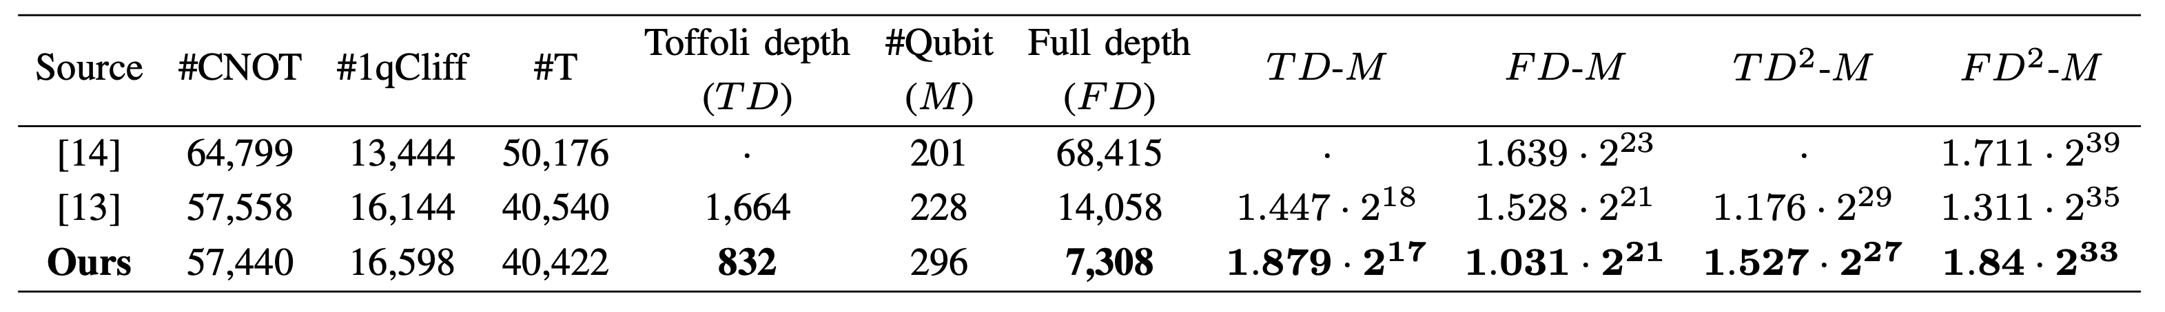
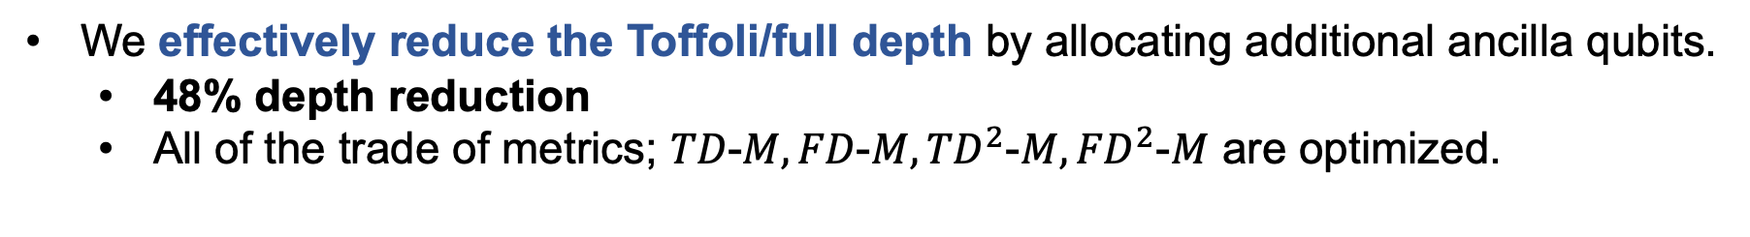
HIGHT quantum circuit
We effectively reduce the Toffoli/full depth by allocating additional ancilla qubits.
48% depth reduction
All of the trade of metrics; $TD\text{−}M, FD\text{−}M, {TD}^{2}\text{−}M,{FD}^{2}\text{−}M$ are optimized.

Slide 16
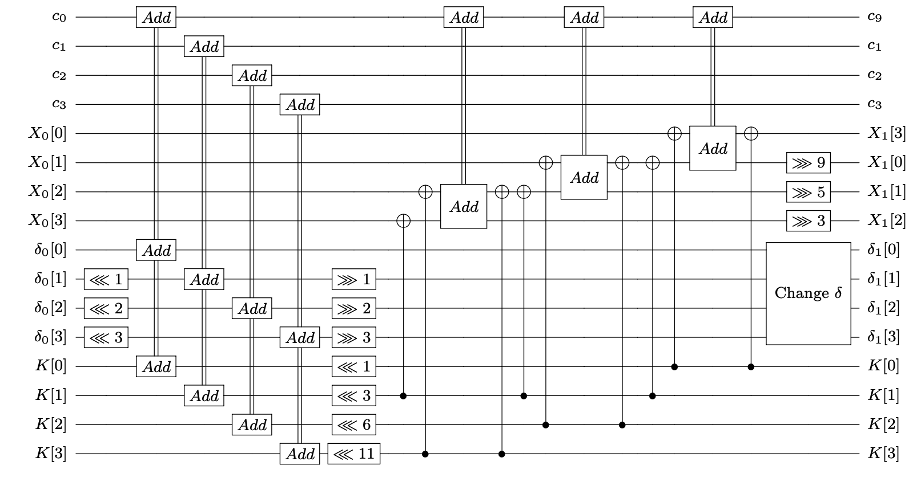
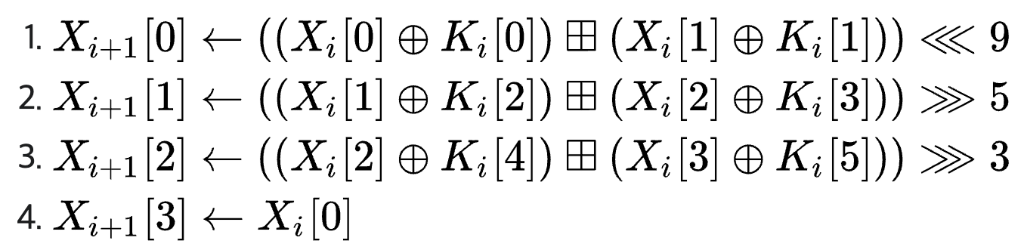
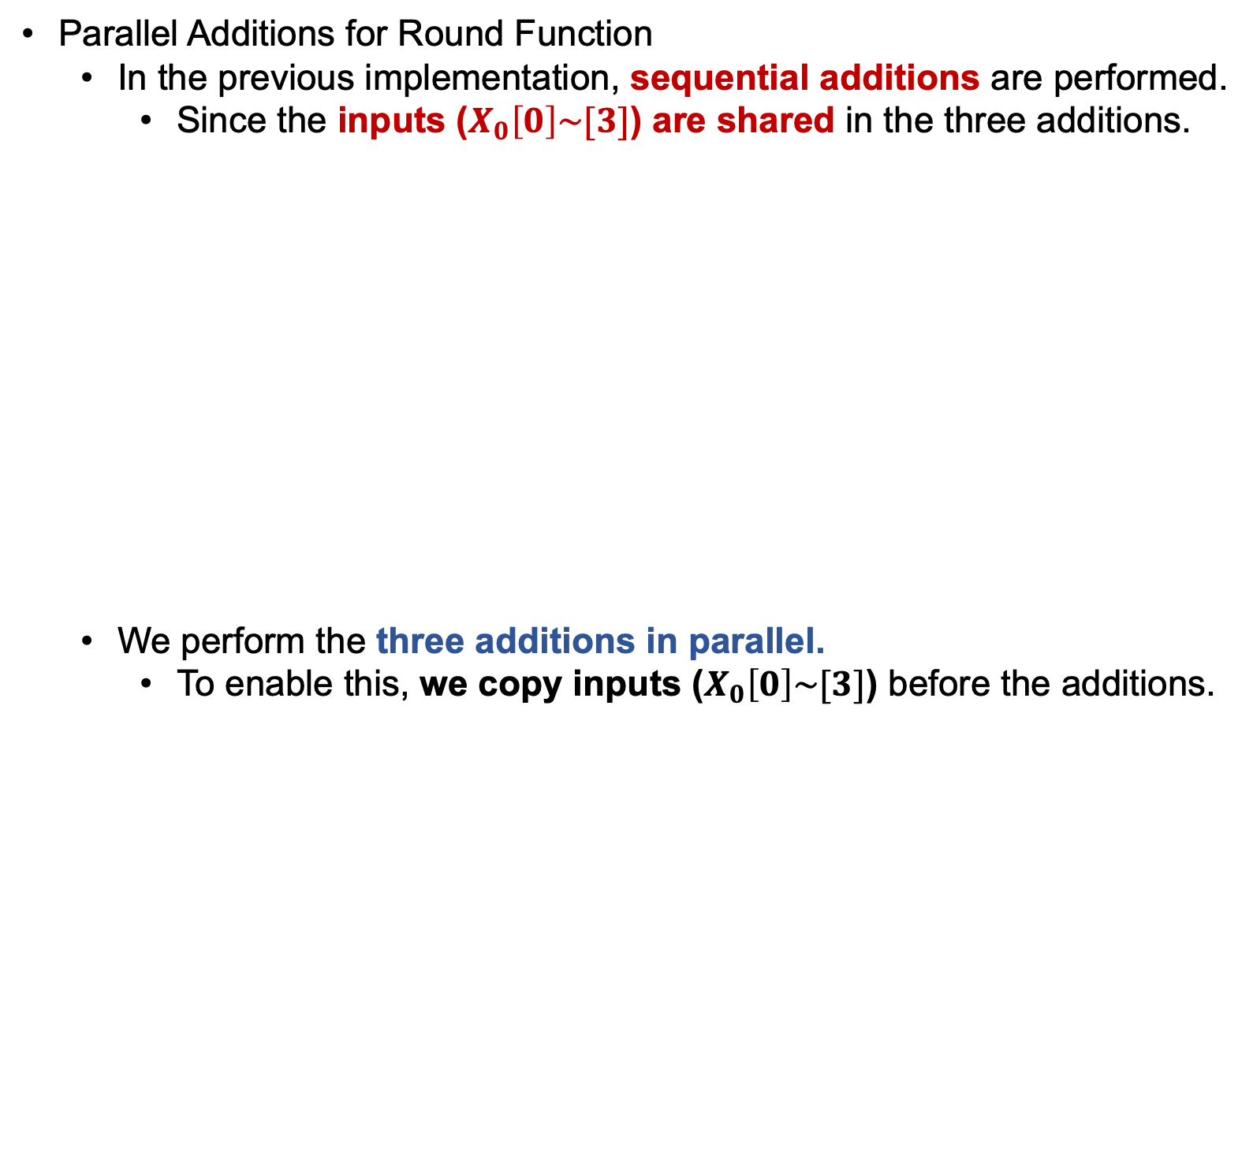
LEA quantum circuit
Parallel Additions for Round Function
In the previous implementation, sequential additions are performed.
Since the inputs ($X_{0}\left[0\right]\sim [3]$) are shared in the three additions.
We perform the three additions in parallel.
To enable this, we copy inputs ($X_{0}\left[0\right]\sim [3]$) before the additions.
#
Shared
Sequential
*
Jang et al “Parallel Quantum Addition for Korean Block Ciphers”, Quantum Information Processing, 2022.

Slide 17
LEA quantum circuit
The subsequent key schedule and the current round function can be executed in parallel.
As we did before, to enable this, we allocate additional ancilla qubits.
Round function
Round function
Key schedule
Key schedule
Current round
Subsequent round
*
Jang et al “Parallel Quantum Addition for Korean Block Ciphers”, Quantum Information Processing, 2022.

Slide 18
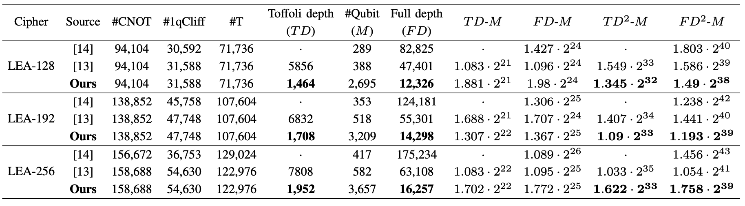
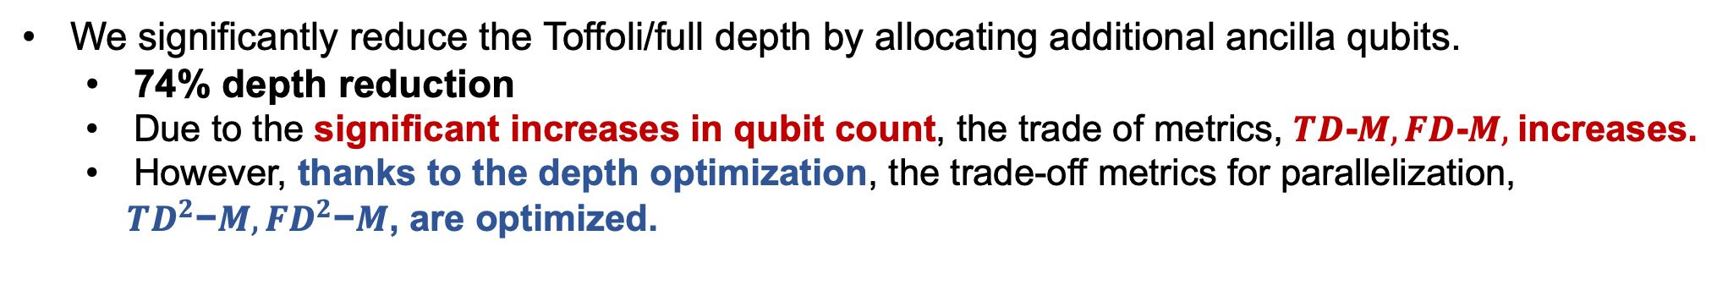
LEA quantum circuit
We significantly reduce the Toffoli/full depth by allocating additional ancilla qubits.
74% depth reduction
Due to the significant increases in qubit count, the trade of metrics, $TD\text{−}M, FD\text{−}M,$increases.
However, thanks to the depth optimization, the trade-off metrics for parallelization,
${TD}^{2}\text{−}M,{FD}^{2}\text{−}M$, are optimized.

Slide 19
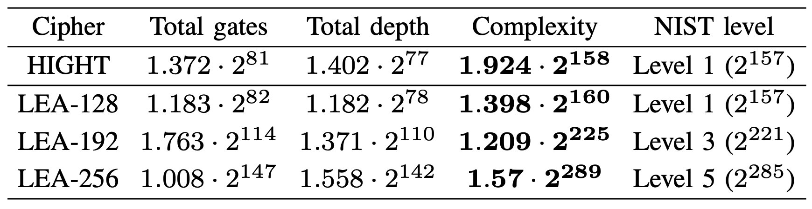
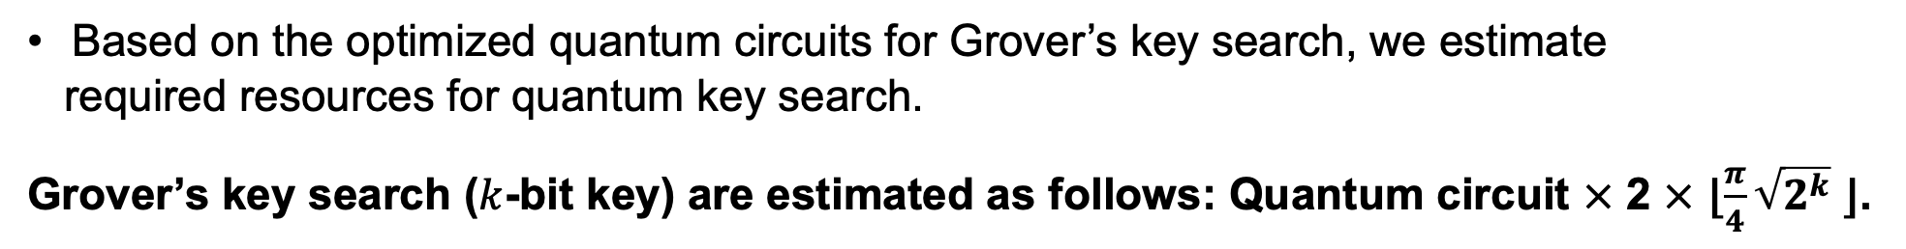
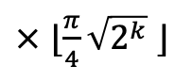
Evaluation of Post-Quantum Security
Based on the optimized quantum circuits for Grover’s key search, we estimate
required resources for quantum key search.
Grover’s key search ($k$-bit key) are estimated as follows: Quantum circuit $×$ 2 $×$ ⌊$\frac{π}{4}\sqrt{2^{k}}$ ⌋.
$×$ ⌊$\frac{π}{4}\sqrt{2^{k}}$ ⌋
# Recall this
We evaluate the post- quantum security level suggested by NIST.
Level 1, 3, and 5 correspond to the attack complexity for AES-128, -192, and -256, respectively.
HIGHT and LEA achieve the appropriate post-quantum security level according
to the key size.

Slide 20
Conclusion
Multiple techniques are gathered in this work to effectively reduce circuit depth.
(such as shallow architecture and copying for parallel operation)
Depth-optimized quantum circuits offer optimal performance for Grover’s key search.
We provide the lowest quantum attack complexity and the best trade-off performance for major metrics under the depth constraint.
We re-evaluate post-quantum security for HIGHT and LEA (with NIST standard).
The quantum circuit of the target cipher is a fundamental block in quantum
cryptanalysis.
Thus, the quantum circuits in this work can be utilized for other quantum algorithms
(not only for Grover’s exhaustive search).

Slide 21
Thank you!

